Slide 1

Exploratory Data Analysis(EDA) for Real Estate Pricing
By: Shailendra Nogia
NEXTHIKES IT SOLUTIONS PROJECT

Slide 2
Project Overview:
Objective: To analyze residential housing data and identify the key factors influencing House sale prices, and to prepare a clean, feature-rich dataset for accurate price prediction.
Perform EDA includes Univariate, Bivariate and Multivariate analysis
Perform feature engineering, and outliers treatment.
Prepare data for accurate price predictions

Slide 3
Library used:
Python
Pandas : data manipulation
Numpy : numerical operations
Matplotlib & Seaborn: data visualization
Jupyter notebook: execution

Slide 4
Dataset Overview:
Dataset contains 1,460 residential properties with 81 features
Numerical and Categorical variables
Target variable: Sale Price
Data Preprocessing:
Handle missing values
Unnecessary columns were removed
Dataset are cleaned and prepared for analysis

Slide 5
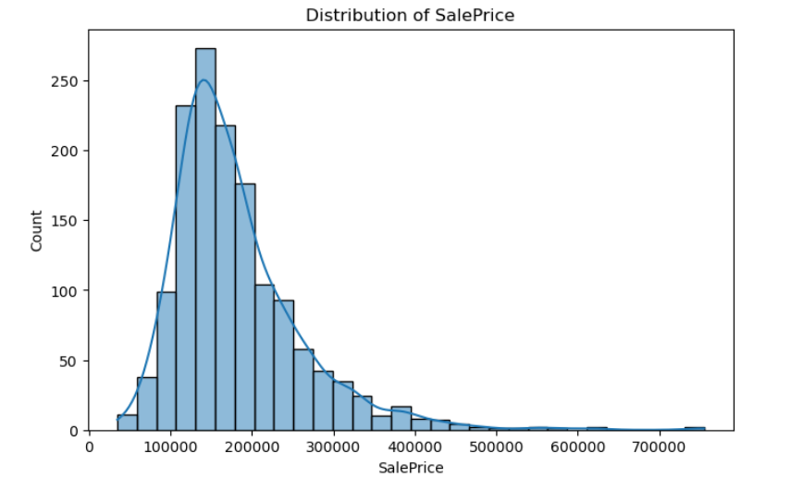
Univariate Analysis:
The distribution for "SalePrice" is right-skewed
most houses are in the lower-to-mid price range, with a few very expensive "outlier" properties.
Most sales occur between 100k and 200k.

Slide 6
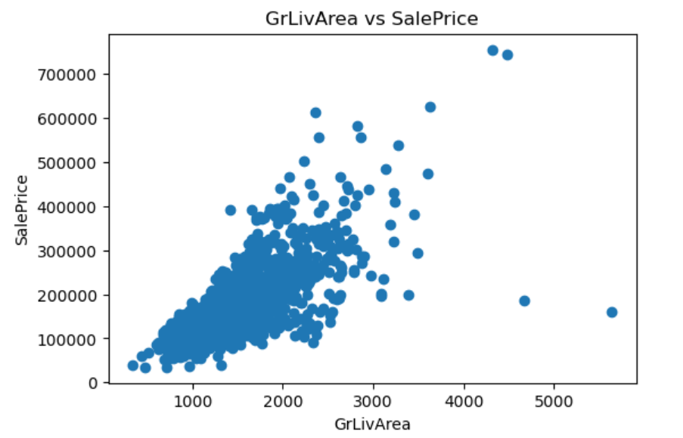
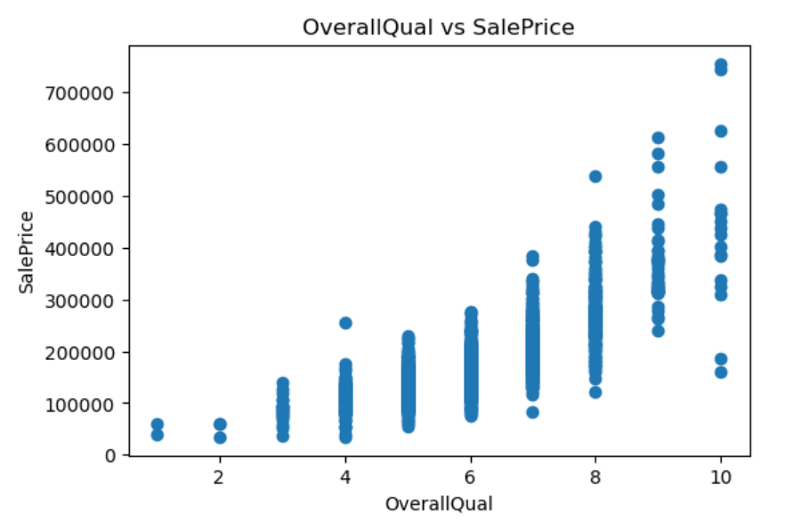
Bivariate Analysis:
Correlation with SalePrice:
- Higher value = stronger relationship with sale price.
- Positive value = as feature increases, price increases.
GrLivArea vs SalePrice → upward slope → bigger houses cost more
OverallQual vs SalePrice → step-like pattern → quality drastically affects price
LotArea vs SalePrice → weaker relationship, more spread.

Slide 7
Multivariate Analysis:
SalePrice → Target / what we want to predict
GrLivArea → Above-ground living area (square feet) — strong size indicator
OverallQual → Quality rating (1–10) — biggest price driver
GarageCars → How many cars garage can hold — affects value
TotalBsmtSF → Basement size — extra usable space increases price

Slide 8
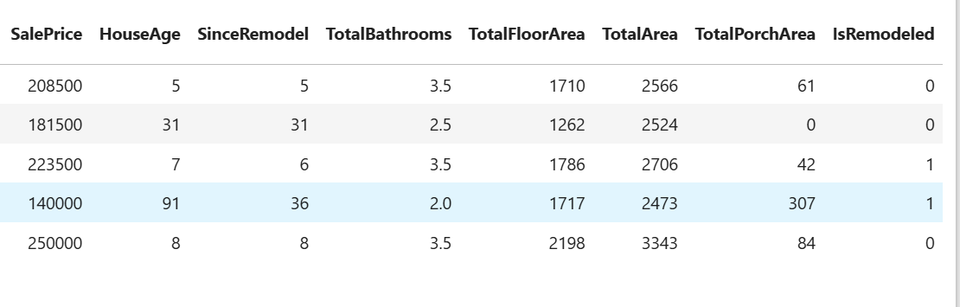
Feature Engineering:
Feature engineering involves creating new variables that contains important information not explicitly present in the dataset.
In this step, new features are created to better explaining House pricing.
Created New Features:
HouseAge = YrSold − YearBuilt
TotalArea = GrLivArea + TotalBsmtSF
TotalBathrooms = Full + Half + Basement baths
TotalPorchArea = Open + Enclosed + Screen Porch
IsRemodeled = YearBuilt ≠ YearRemodAdd

Slide 9
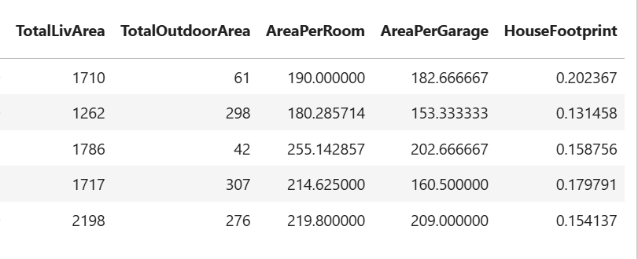
Feature Engineering & Size impact:
TotalLivArea = usable indoor space → strongest predictor
TotalArea = basement + livable → detects luxury homes
TotalFloorArea = footprint * floors → indicates vertical space
AreaPerRoom = room spaciousness → higher spaciousness = higher price
HouseFootprint = house-to-land ratio → shows construction density

Slide 10
Key Observations:
TotalLivArea is the strongest size predictor — models rely heavily on it
Basement adds meaningful value, even though it’s not fully livable
More rooms doesn't always mean higher price, but larger rooms do
LotArea has lower impact — neighborhood & zoning matter more than raw land size
Garage size contributes, but number of garage cars contributes more

Slide 11
Market Trends & Historical Pricing:
Average house prices fluctuated over years
Price dip around 2008–2009, followed by gradual recovery
Newer and recently remodeled homes sold at higher prices
Price-per-square-foot provided clearer market trends than raw prices

Slide 12
Customer Preferences & Amenities:
Most Valued Amenities
Garage capacity (≥2 cars)
Central air conditioning
Fireplaces
Finished basements
Outdoor spaces (porches/decks)
Pools increased value only for premium homes
Buyers prefer comfort + functionality over just size

Slide 13
Key Insights:
Quality + Size together drive pricing
Living area is more important than land area
Amenities significantly influence buyer decisions
Feature engineering improved data expressiveness
Outlier handling enhanced model readiness

Slide 14
Conclusion:
House prices are mainly influenced by living area and overall quality.
Feature engineering (total area, house age, amenities) improved data representation.
Outlier treatment reduced skewness while preserving high-value homes
Buyers prefer larger homes with good quality, garages, and modern amenities.
The dataset is now clean, informative, and ready for accurate price prediction.

Slide 15
What Next ?
Train advanced regression models (Random Forest, XGBoost)
Improve accuracy using feature selection & hyperparameter tuning
Deploy the model using Streamlit for real-time price prediction
Extend analysis with external market data

Slide 16


